Slide 1
Religion as Social Action
Max Weber
RELS 1210 – Class 15
Mandy MacArthur

Slide 2
Theorists so far…
So, at this point, what do all the theorists say about religion?
Tylor & Frazer = animism & magic as a response to the primitive natural world (historical)
Conclusions highlight evolution/development over time
Freud = neurosis as a response to our unconscious mind, need for father figure/protection (functionalist)
Durkheim = creates and is dependent upon society, sense of community and purpose through belonging (functionalist)
Marx = illusion used to distract in order to perpetuate class division, alienates us from our true potential selves (functionalist)
Conclusions are reductionist and simplified

Slide 3
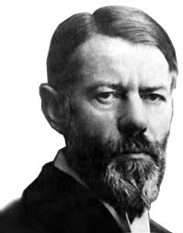
Max Weber
Viewed religion in a much different way than the other theorists
“Society, as he saw it, is best understood as a tapestry of quite different, but tightly interwoven strands of human activity” (144)
Where they would argue that religion was merely a by-product or effect of an underlying simplified cause, her argued it could be the cause itself
It depended on each individual circumstance

Slide 4
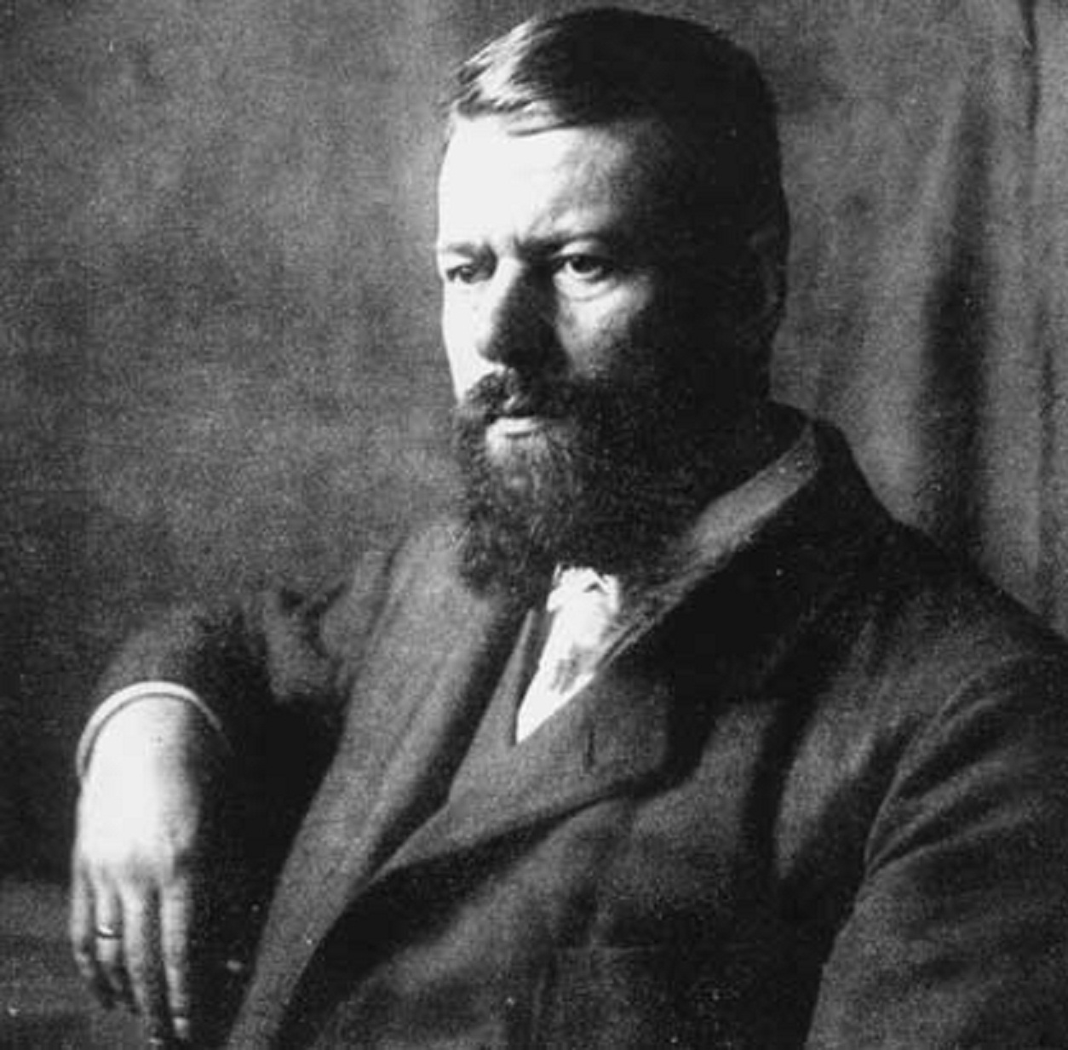
Karl Emil Maximilian Weber
1864-1920
Oldest of eight children
Father was involved with the German government
Mother was highly educated, which was not the norm at that time for women and she came from a wealthy family
She was devoutly religious and was very concerned with working to help the poor
His parents disagreed and fought a lot about their values
Weber would grow up to share both of his parents’ attributes – w/ an interest in law and politics, but also a concern for ethics and humanitarian idealism

Slide 5
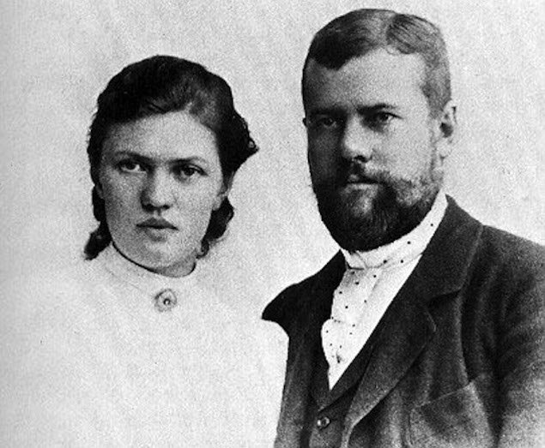
Was a keen scholar from a young age as his household was full of engaged discussion on various topics and local scholars, philosophers, and government officials
Also studied, like Marx, at the university of Berlin and studied law and economic history
At 29, he married Marianne Schitger and they had an unusual marriage
They decided not only to not have children, but also to not have any sexual relations
It was a mutually platonic relationship, but would later be argued as contributing to his mental decay

Slide 6
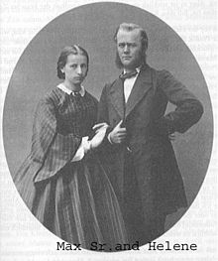
Strained personal relationships
He also had a strained relationship with his parents, as they fought often and he would have to choose sides
In the end, he would side with his mother most of the time, and this caused an estrangement from his father
His father had a sudden heart attack before they could reconcile
The stress of his personal life lead to crippling anxiety and depression, and ultimately led him to resign as a professor after multiple health issues
However, due to an inheritance and his own wealth, he was able to study and work on his own
He conducted social research and wrote over the period of 16 years
Including critical reviews and his analysis on religion
He died of pneumonia at the age of 56 in 1920

Slide 7
Weber’s work is often thought of as a dialogue with the ghost of Karl Marx
Highly influenced by Marxist materialistic thought
He rejected both Hegel’s idealism AND Marx’s materialism
He believed that religion has its own independent “voice”
Refused to actually define religion, but he saw it as expressing humanity’s ongoing attempt to impose order and discern meaning
Used the sociological method to investigate religion, but acknowledged it had its issues…

Slide 8
Sociological Method of Weber
Main issue of the sociological method: how do we proceed when we try to explain human social actions?
“Weber developed his answers to this question in several technical essays that outline three guiding principles of social inquiry” (147)
1. Verstehen
2. Ideal-Typus
3. Values

Slide 9
VERSTEHEN
German term for understanding
Interpretive sociology
“we cannot explain the actions of humans as we explain occurrences in nature” (147)
Humans are far more complex due to consciousness and they way we assign meaning to our actions
Guided by emotions
So he negated that humans could be examined using the same method as physics and chemistry and by using universal laws → this was highly controversial
He believed there is fundamental difference between the science/laws of nature and the science of human culture
Therefore, we must use verstehen to explore the minds of humans and their actions
But, we had to proceed with caution and rationale by looking for motives and meaning

Slide 10

IDEAL-TYPUS
German term for ideal type
The ideal or perfect version of a phenomenon
General concept, but not a generalization
Almost like providing the parameters or definition for the perfect thing
Adding specific characteristics
Creates a conceptual framework to use for analysis and comparisons
Used to measure against actual occurrences in the real world
Then these are used to explain human action across cultural and geographical bounds, as well as time periods

Slide 11
VALUES
Facts do not equate with values
“every true scientist seeks a factual account of the real world as he [she] experiences it, and personal value judgements should be kept out of the process” (151)
Was this true of our former theorists??
Weber acknowledged that there were certain values that could not or should not be ignored or avoided
This is particularly important in “fluid” studies that change and evolve over time
We must also acknowledge that at any given time in social science studies, we are negotiating 2 sets of values:
1. those of the people being interpreted
2. those of the culture in which they are working
Weber used all 3 of these principles together in order to investigate religion and human action, and religion’s role in society and the economy

Slide 12
2 Main Writings
The Protestant Work Ethic and the Spirit of Capitalism
The Sociology of Religion

Slide 13
The Protestant Reformation
16th century Europe
Martin Luther and John Calvin
Division of the Catholic Church
Aimed at “reforming” the Church with a concentration on different doctrine
Shift in doctrine as a critique
Lutherans and Calvins
Impacted by the Renaissance and Humanism
Altered the view of labor and work → dignifying it as blessed by God
Economic gain was a by-product of doctrines of faith that encouraged hard work and self-restraint

Slide 14
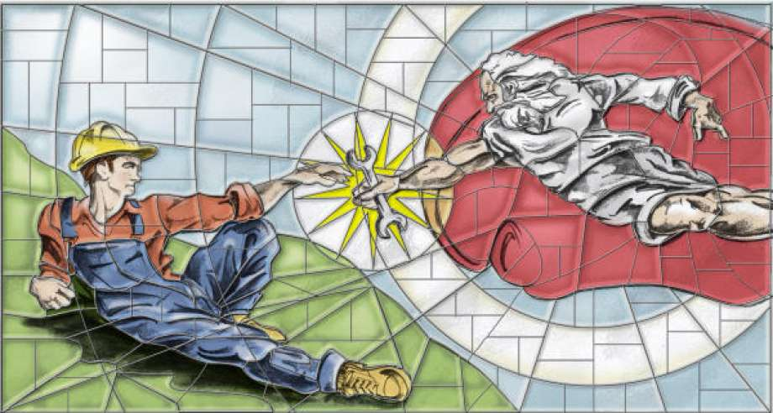
The Protestant Work Ethic
Concept that came out of the Protestant Reformation that emphasized that hard work and discipline come from being Protestant and holding those values
Weber argued that this caused large amounts of people to start working in the “secular” world, and this created and directly contributed to modern capitalism
This was the reversal of the natural state of things
There was a sense of duty to do so in the modern world

Slide 15
Weber notes the ascetic character of the ‘modern’ entrepreneur:
“… he gets nothing out of his wealth for himself, except the irrational sense of having done his job well”
Money making had become a calling
A life acceptable to God had changed – it did not mean being in a monastery or nunnery; it meant fulfilling one’s role in the world
The Good Life was no longer one of withdrawal and contemplation, but was according to whatever condition a person found within themselves
Therefore labor was seen as “brotherly love”
Profit was then seen as an opportunity given by God
So, you must work hard in the world = God helps those who help themselves
This was not a biblical teaching, but a contextualized understanding of the Prostestant Reformation
This was the explanation of the class structure = it was God’s will that one becomes wealthy; the unequal distribution of wealth is a sign of divine providence

Slide 16
The Sociology of Religion
1920 as a chapter of a larger publication
Effects of religious action vs. non-religious action
Uses Verstehen to categorize different religions and religious understandings of an individual in an attempt to discern its subjective meaning
An attempt to understand religion as a human value response that prescribes meaning to the human experience – life, death, illness, suffering, aging, love, etc.
Argues that religions provide a way for people to define and achieve their goals
This is how he connects religion to the rise of modern capitalism → the Protestant work ethic → vessel to achieve a goal
Religious beliefs help to dictate society, economy, politics, culture, etc.
Applies a broader set of interpretive categories to world religions, rather than just Christianity

Slide 17

“religion for Weber is rooted in special experiences, what he calls ‘ecstatic states,’ that put people beyond the realm of everyday activity and disclose to them another level of reality.” (159)
A person with charisma has a gift that allows them to harness a special talent for those experiences and uses this power to rise to the role of a religious leader
In primitive cultures, the magician would be an example of a person with charisma

Slide 18
Priests
PRIESTS
However, priests differed from magicians as a more regular day to day leader
“We find religious priesthood where there is some kind of permanent system of worship at fixed times and places and associated with a definite religious community.” (159)
The charisma here is established through the priest’s office/title, rather than personal characteristics
Professionals in religion (authoritative)
“Dispensing religious guidance and benefits to clients, and above all, they prize social and religious order” (160)

Slide 19
Prophets
PROPHETS
Not a magician or priest, but ultimately, has the most commanding sense of charisma
“The prophet may appear at any time in a culture, acting on a powerful sense of mission, to proclaim to all a comprehensive ‘religious doctrine or divine commandment’.” (160)
Called upon by God or a vision of Ultimate Truth
Power does not come from their title/office, but from their life-altering message
Weber argues that all the major religions can trace their origins to a charismatic and prophetic figure
From these ideal-type figures, the remaining community must keep the charisma going → thus is born the religious community
This highlights the importance of the laity in the religious structure
Without their charisma as well, the system would stagnate
“Charisma, in prophetic or any other form, does not exist unless a community of laypeople comes to recognize and reinforce it” (162)

Slide 20
Evil and Suffering
The mystery of Theodicy
2 main ideal types to deal with suffering
1. Human Effort
Salvation through ritualized action
Focuses on good work done repeatedly over time & tallied up
Ideal-type of Virtuoso Sanctification
“They seek to be supreme artists of the moral life” (165)
2. Salvation is given
Salvation is not worked for; it is a gift
Humans can do no action that can affect their own salvation/end of suffering
It is a gift from an outside source

Slide 21
RELIGION AS SOCIAL ACTION
Weber focused more on # 1 and believed that religion highly influenced social action, driven by moral doctrine
Action in the present world would/did affect the after life or next life
For Weber, there is no such thing as intellectual evolution/social progression
Weber does not use a functionalist reductionism
Freud, Durkheim, and Marx all contend that religion’s origins is a non-religious cause: psychological, sociological, and socio-economic
Whereas Weber claims, “human ideas, beliefs, and motives deserve to be counted as real and independent causes of human action (176)
This very much includes all aspects of religion
RELIGION PROVIDES MEANING AND SUBSEQUENTLY MOTIVATES ACTION

